Slide 1

ADOxx HowTo BPMN Modeling PP2, HSRT

Slide 2
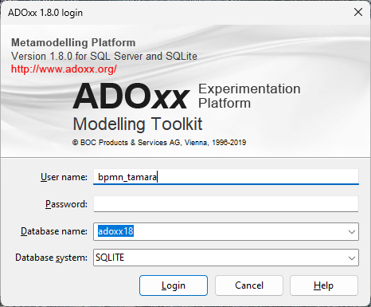
Getting Started
Open the ADOxx Modeling Toolkit and login using the credentials you set for your user.
(Refer to DECIDE ADOxx – HowTo Installation)

Slide 3
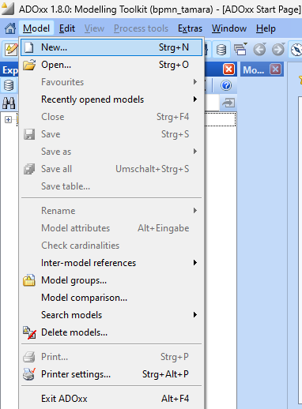
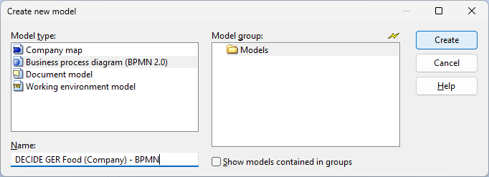
Getting Started
Create a new BPMN model by clicking „Model“ in the top left corner.
Select „New“, chose „Business Process Diagram (BPMN 2.0)“ as the model type and select a fitting name.

Slide 4

Modeling BPMN
You can find all BPMN 2.0 elements in the hotbar on left side of the model page.
The ADOxx implementation of BPMN works in accordance with the official OMG specification.
(Further information: OMG)

Slide 5
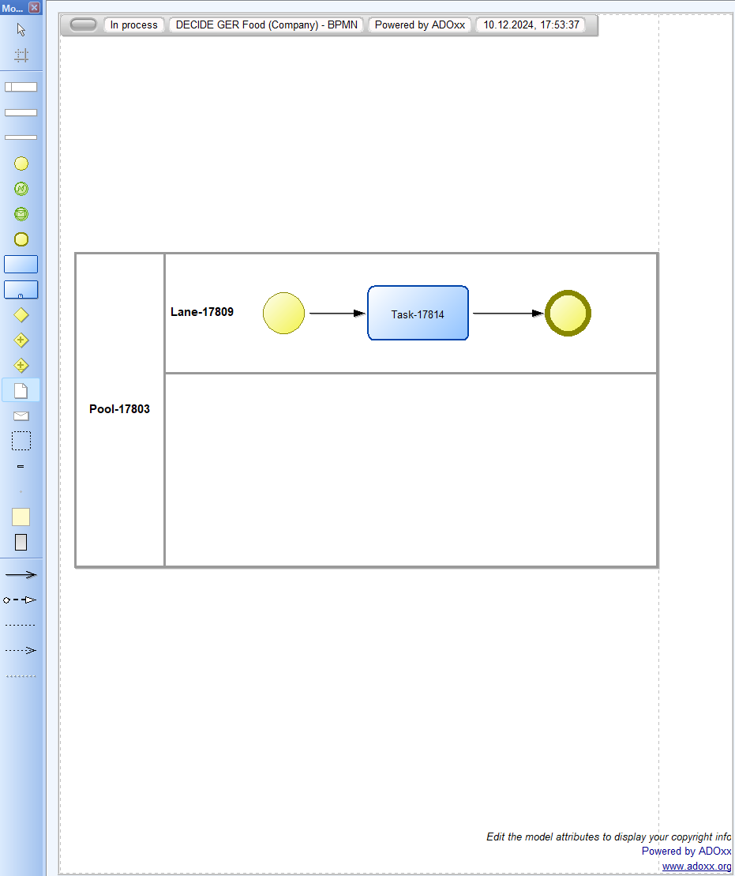
Modeling BPMN
By left-clicking on any element and then left-clicking on the desired position indicated by the pencil, we can draw the modeling elements.
Arrows can be drawn by left-clicking the starting element and dragging the arrow the the ending element.
Pressing ESC will cancel the selection and stop creating new elements on left-click.

Slide 6
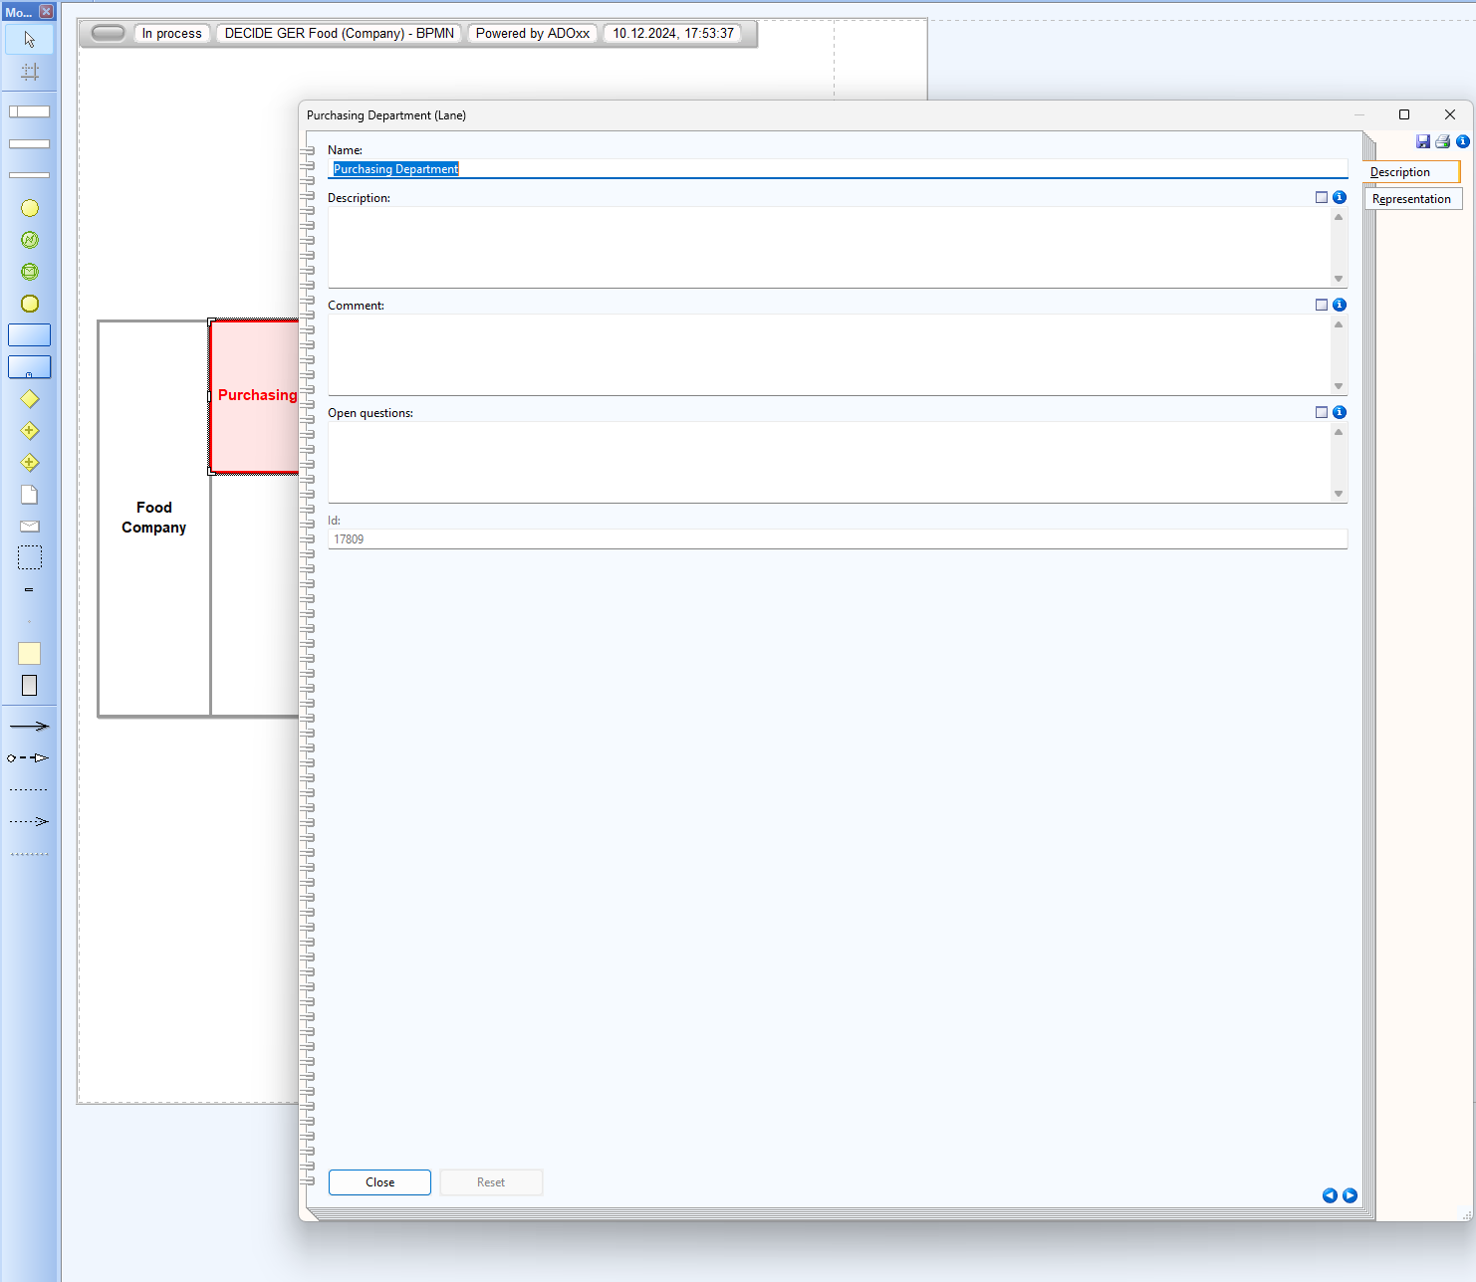
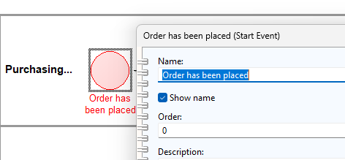
Modeling BPMN
You can change the name by double-clicking on any element (including arrows).
For those elements that don‘t naturally carry names, „Show name“ needs to be ticked if a name shall be shown.

Slide 7
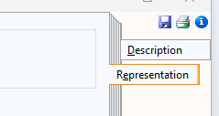
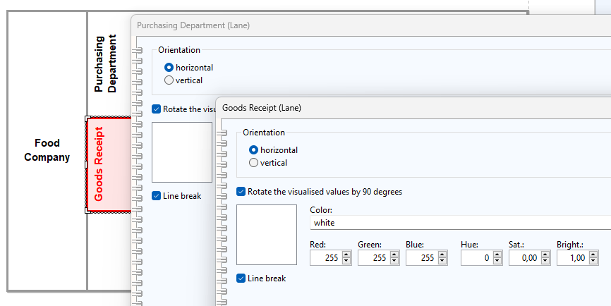
Modeling BPMN
You can change the representation of most elements in the „Representation“ section to increase readability.

Slide 8
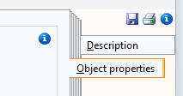
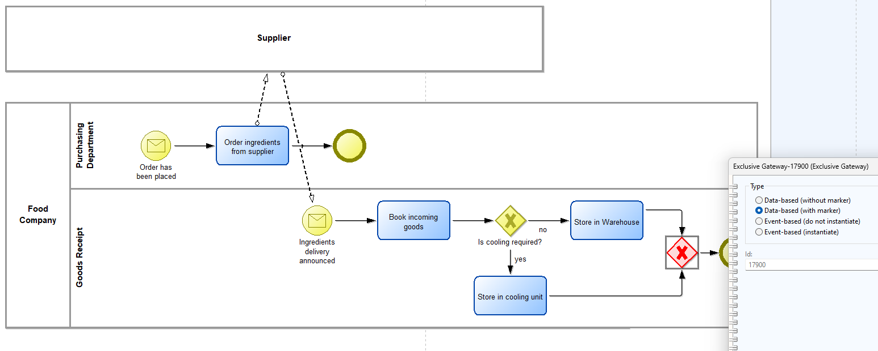
Modeling BPMN
In the „Object Properties“ section of gateways, or the „Event Type“ section of event elements, you can change the types to fit your process model needs.

Slide 9
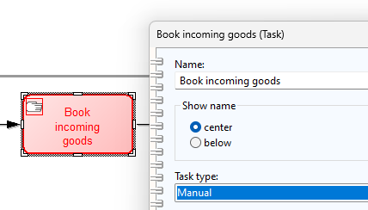
Activities
Activities are work units or tasks performed within a business process. They represent specific actions, such as manual tasks, automated processes, or complex operations (e.g., subprocesses), that contribute to achieving the process's objectives.
In the objects description, you can select the task type.

Slide 10
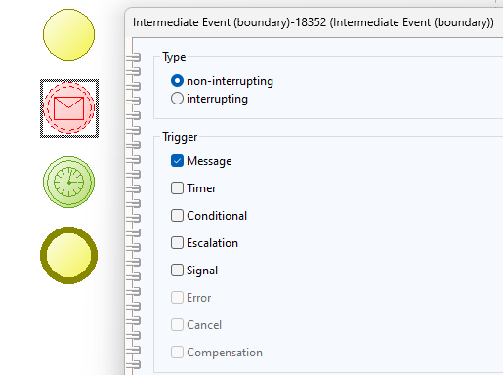
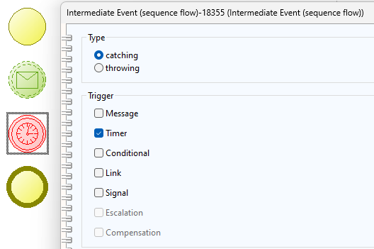
Events
Starting Events initiate a Process.
Intermediate Events happen during a process and can be of the type:
Boundary (placed on the boundary of an activity, used to handle exceptions or conditions that may interrupt the activity)
Sequence-flow (placed along the sequence flow between activities, events occur as part of the normal process flow, does not interrupt activities but adds logic to the process flow)
End events end a Process.

Slide 11
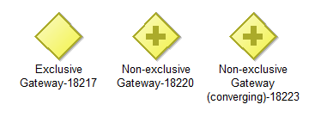
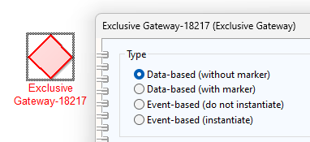
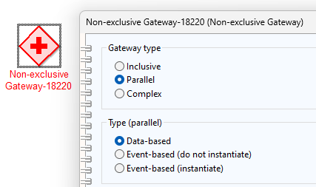
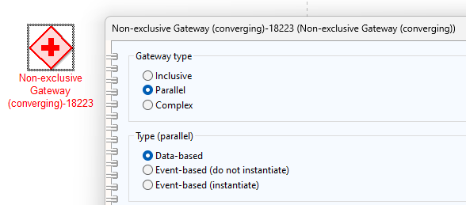
Gateways ”The term “gateway” implies that there is a gating mechanism that either allows or disallows passage through the Gateway; that is, as tokens arrive at a Gateway, they can be merged together on input and/or split apart on output as the Gateway mechanisms are invoked.”
There are three different gateway types available:
Exclusive Gateways
Non-exclusive Gateways
Non-exclusive Gateways (converging)
Specifying these gateways happends via their properties.

Slide 12
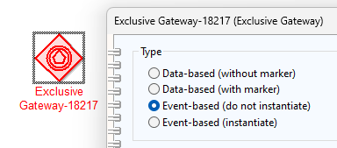
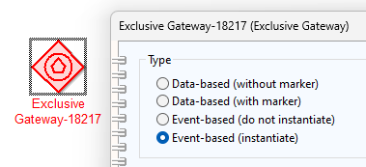
Gateways „Exclusive Gateway“ → Data-based
The Event-Based Gateway represents a branching point in the Process where the alternative paths that follow the Gateway are based on Events that occur, rather than the evaluation of Expressions using Process data.
A specific Event, usually the receipt of a Message, determines the path that will be taken. Basically, the decision is made by another Participant, based on data that is not visible to Process
The “instantiate” gateway is used to instantiate a process and must not have any incoming sequence flows.

Slide 13
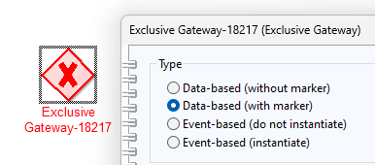
Gateways „Exclusive Gateway“ → Event-based
A diverging Exclusive Gateway (Decision) is used to create alternative paths within a Process flow. This is basically the “diversion point in the road” for a Process. For a given instance of the Process, only one of the paths can be taken.
The Exclusive Gateway MAY use a marker that is shaped like an “X” and is placed within the Gateway diamond to distinguish it from other Gateways.
A diagram SHOULD be consistent in the use of the “X” internal indicator. That is, a diagram SHOULD NOT have some Gateways with an indicator and other Gateways without an indicator.

Slide 14
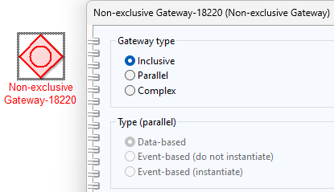
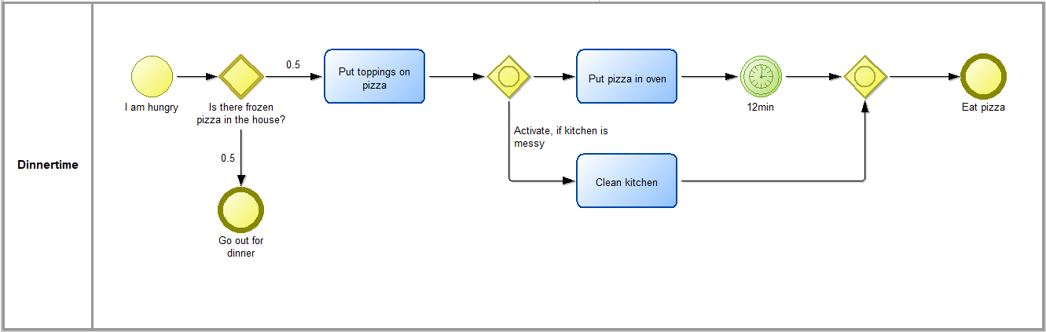
Gateways „Non-exclusive Gateways“ → Inclusive
Unlike the Exclusive Gateway, all condition Expressions are evaluated. The true evaluation of one condition Expression does not exclude the evaluation of other condition Expressions. All Sequence Flows with a true evaluation will be traversed by a token.
A converging Inclusive Gateway is used to merge a combination of alternative and parallel paths. A control flow token arriving at an Inclusive Gateway MAY be synchronized with some other tokens that arrive later at this Gateway.

Slide 15
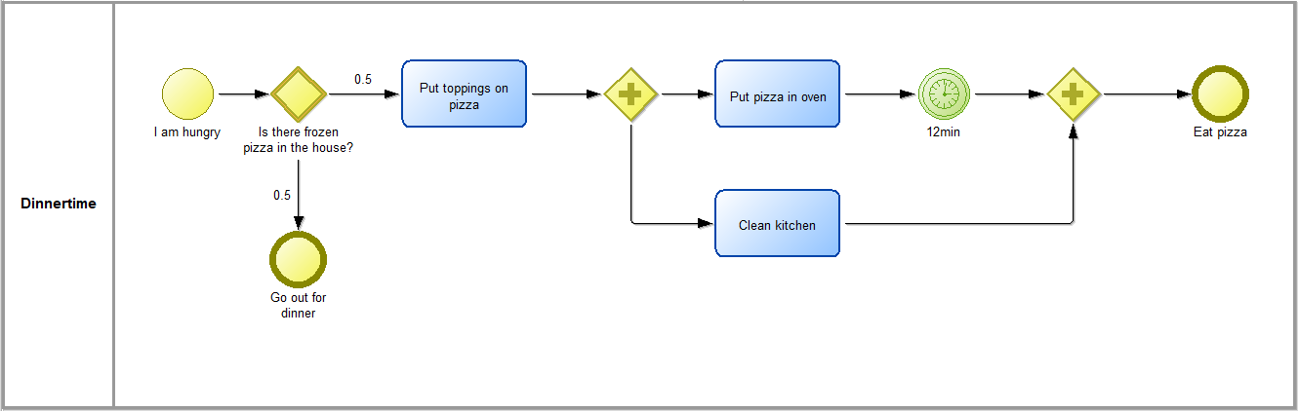
Gateways „Non-exclusive Gateways“ → Parallel
A Parallel Gateway creates parallel paths without checking any conditions; each outgoing Sequence Flow receives a token upon execution of this Gateway.
For incoming flows, the Parallel Gateway will wait for all incoming flows before triggering the flow through its outgoing Sequence Flows.

Slide 16
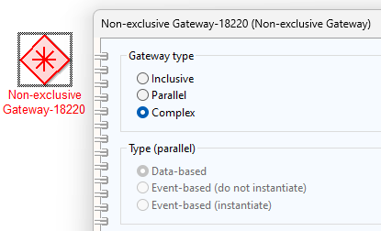
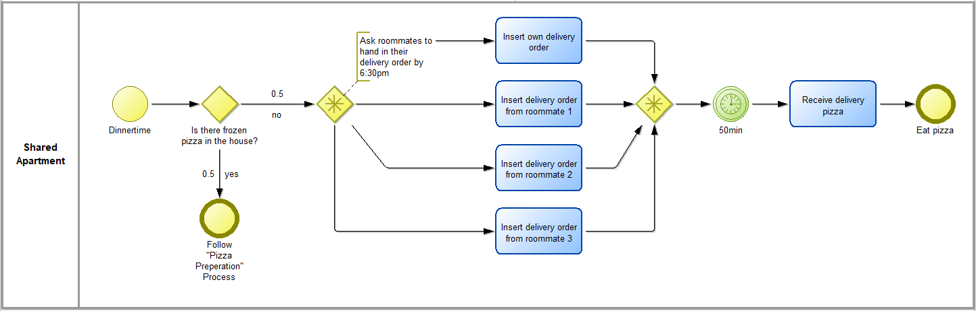
Gateways „Non-exclusive Gateways“ → Complex
The Complex Gateway can be used to model complex synchronization behavior. For example, this Expression could specify that tokens on three out of five incoming Sequence Flows are needed to activate the Gateway.
In the given example, the gateway requests from all roommates to provide their delivery order by 6:30 pm. The minimum threshold for the process to continue is one. This translates to:
If at least one delivery order has been received by 6:30, the process will continue, regardless if the others have arrived or not. If the orders are provided after 6:30, the gateway will reset.

Slide 17
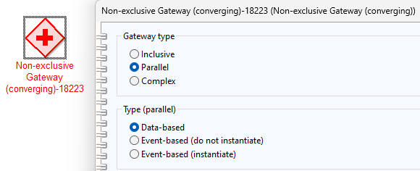
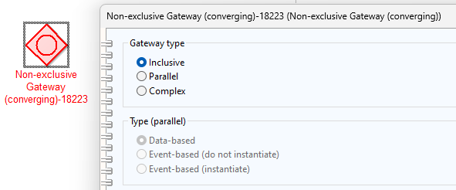
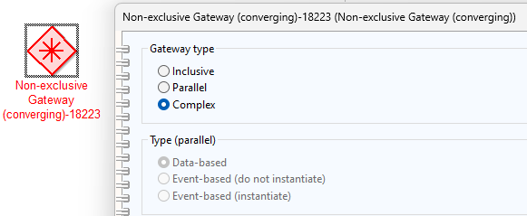
Gateways „Non-exclusive Gateways (converging) “
Converging: These Gateways MAY have multiple incoming Sequence Flows but MUST have no more than one (1) outgoing Sequence Flow
Converging Gateways are used to bring previously diverged paths back together
Depending on the Gateway and the synchronization parameters, different simulation behavior can be represented
Converging Gateways can be:
Inclusive
Parallel
Complex

Slide 18
Gateways „Non-exclusive Gateways (converging) “
Converging: These Gateways MAY have multiple incoming Sequence Flows but MUST have no more than one (1) outgoing Sequence Flow
A converging Inclusive Gateway is used to merge a combination of alternative and parallel paths. A control flow token arriving at an Inclusive Gateway MAY be synchronized with some other tokens that arrive later at this Gateway.
A converging Parallel Gateway is used to synchronize (combine) parallel flows.
A converging Compley Gateway uses the semantics of an Inclusive Gateway to determine whether it needs to wait for additional tokens

Slide 19
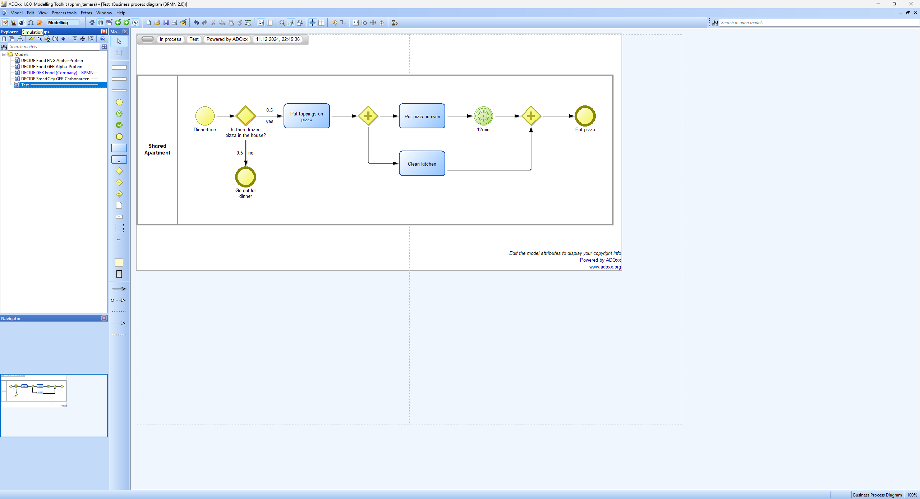
Simulation Can help to answer the following questions:
How long does a process take on average?
What is the capacity utilization of the resources?
What happens if we increase the process throughput by X%?
Where does a process have bottlenacks when activities wait for conditions?

Slide 20
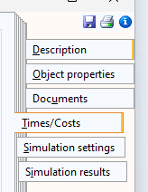
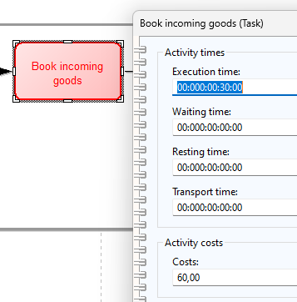
Simulation
In the Times/Costs section you can enter information for each process step on:
How much time this activity requires (split in execution, waiting, resting, and transport time i.a.)
How much this activity costs (e.g. personell costs for this amount of time for a manual activity)
Wage: 60€ / hour
Additional costs for employee: 60€ / hour
Time spent on activity: 30 min
= 60€ costs for 30min activity

Slide 21
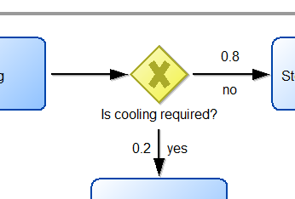
Simulation
For simulating the process, it is important to provide the tool information on how to deal with gateways.
For Exclusive Gateways this means to provide a Probability of occurence.
„Cooling is required for 20% of the products delivered, whereas 80% can be stored in the regular storage“

Slide 22
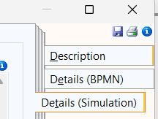
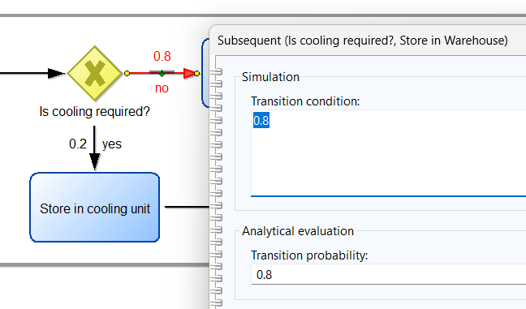

Simulation
In the Details (Simulation) tab of the Arrows leaving the Exclusive Gateway you can set the probability in the Transition Condition field.
Note: In this case, the value is also inserted in the Transition Probability for displaying the value in the model alongside of the semantic transition condition.
(
)

Slide 23
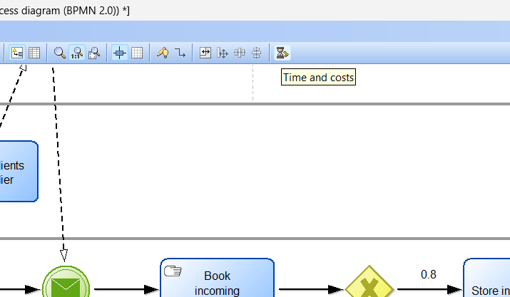
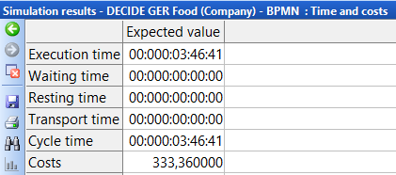
Simulation Time & Cost
Clicking the Time & Cost button in the top right corner of the action row performs a quick one-time-run cost and time analysis.
(Modeling tab)

Slide 24

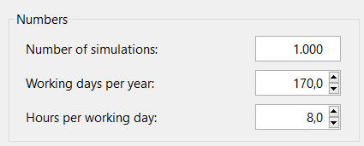
Simulation Path Analysis
Changing to the Simulation Tab, you can define more precise simulation parameters. One of which is a Path Analysis. This simulation analyzes how often the individual paths of the entire process are executed for x-amount of runs. This becomes more relevant the more gateways and decision logics there are within a process.
Here, you can choose how often the process should be simulated and provide the amount of working days per year and hours per working day.

Slide 25
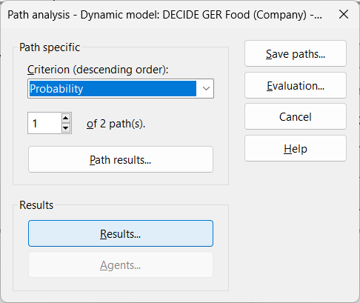
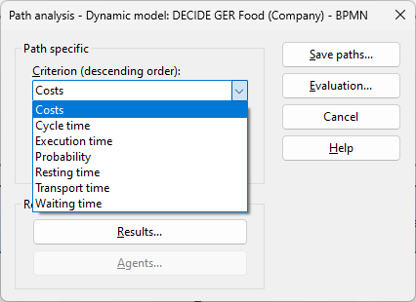
Simulation Path Analysis
For the Path Analysis you can chose between different Cirteria to be evaluated.
Clicking on Path Results… provides the information for the selcted path.
Clicking on Results… provides the overall process results, a view identical to the Time & Cost results.

Slide 26

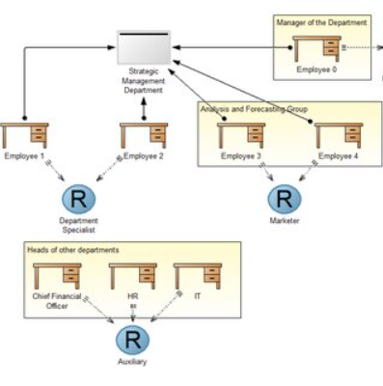
Simulation Capacity & Workload Analyses
In order to make a Capacity or Workload Analysis, it is necessary to combine the BPMN with a Working Environment Model.
Information on how to do this will b provided later on.

Slide 27
Further Information
Additional hints and information on BPMN modeling and simulation in ADOxx can be found here: Omilab Case Study (pp.41)
For an overview of the BPM Notation and a detailed description of all elements, please refer to the BPMN Specs.
Additionally, Camunda explains the usage of the individual BPMN elements on an example-base.

